Slide 1





PYTHON
GETTING STARTED

Slide 2

PYTHON INSTALL
Many PCs and Macs will have python already installed. To check if you have python installed on a Windows PC, search in the start bar for Python or run the following on the Command Line (cmd.exe):
To check if you have python installed on a Linux or Mac, then on linux open the command line or on Mac open the Terminal and type:
If you find that you do not have Python installed on your computer, then you can download it for free from the following website: https://www.python.org/

Slide 3
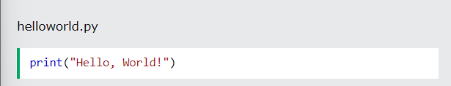
PYTHON QUICKSTART
Python is an interpreted programming language, this means that as a developer you write Python (.py) files in a text editor and then put those files into the python interpreter to be executed.
The way to run a python file is like this on the command line:
Where "helloworld.py" is the name of your python file.
Let's write our first Python file, called helloworld.py, which can be done in any text editor.

Slide 4
PYTHON QUICKSTART
Simple as that. Save your file. Open your command line, navigate to the directory where you saved your file, and run:
The output should read:
Congratulations, you have written and executed your first Python program.

Slide 5
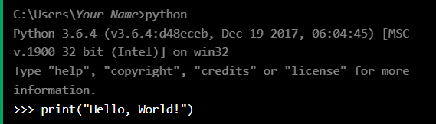
THE PYTHON COMMAND LINE
To test a short amount of code in python sometimes it is quickest and easiest not to write the code in a file. This is made possible because Python can be run as a command line itself.
Type the following on the Windows, Mac or Linux command line:
Or, if the "python" command did not work, you can try "py":
From there you can write any python, including our hello world example from earlier in the tutorial:

Slide 6
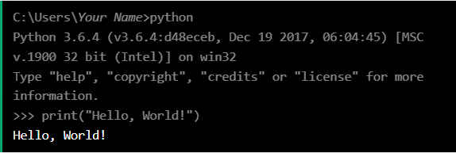
THE PYTHON COMMAND LINE
Which will write "Hello, World!" in the command line:
Whenever you are done in the python command line, you can simply type the following to quit the python command line interface:

Slide 7
THANK YOU

